Slide 1
Lamorinda CERT Triage For All Ages
Updated: 26 August 2017
Notes:
0

Slide 2
How Prepared Are You?
You came into this room
-did you size up?
Exit Points
Fire Extinguishers
AED Defibrillator locations
Hazards
Assembly Area

Slide 3
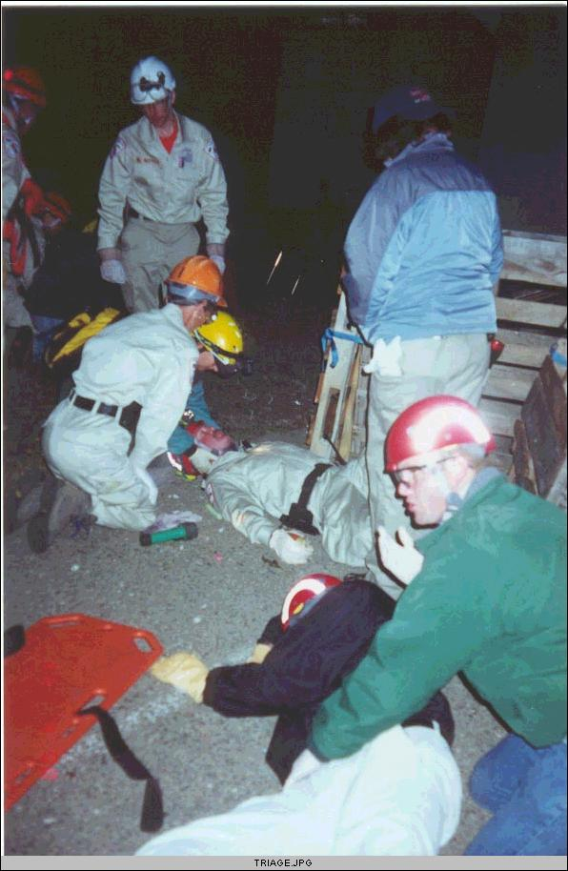
Triage
TRIAGE – French term meaning “to sort ”
Triage is the medical screening of patients according to their need for treatment and the resources available. It applies to mass casualty situations, when conventional standards of medical care cannot be delivered to all victims.
The goal is to optimize care for the maximum number of salvageable patients.
Triage is a Perishable Skill and must be practiced regularly

Slide 4
Ethical Justification
This is one of the few places where a "utilitarian rule" governs medicine: the greater good of the greater number rather than the particular good of the patient at hand. This rule is justified only because of the clear necessity of general public welfare in a crisis.
A. Jonsen and K. Edwards, “Resource Allocation” in Ethics in Medicine, Univ. of Washington School of Medicine, http://eduserv.hscer.washington.edu/bioethics/topics/resall.html

Slide 5
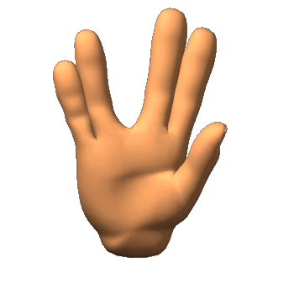
“The needs of the many outweigh the needs of the few or the one.“
Spock in
Star Trek II: The Wrath of Kahn

Slide 6
Primary Disaster Triage
Goal: to sort patients based on probable needs for immediate care. Also to recognize futility.
Assumptions:
Medical needs outstrip immediately available resources
Additional resources will become available with time

Slide 7
Before You Start
Check Scene Safety
Identify approximate number of victims
Don PPE before approaching victim
Introduce yourself and your qualifications
Ask PERMISSION to assess / treat
Try to determine Mechanism of Injury (MOI)
With a conscious patient, ascertain Chief Complaint
Victim has the right to refuse treatment

Slide 8
Triage Steps
Size-up
Conduct voice triage
Follow a systematic route
Start where you stand
Evaluate each victim and tag them
Document Triage results
“Immediates”… bleeding, airway, recovery position
Transfer “Immediates” to medical group immediately!

Slide 9
CERT Size-up
Gather Facts
Assess Damage
Consider Probabilities
Assess Your Situation
Establish Priorities
Make Decisions
Develop Plan of Action
Take Action
Evaluate Progress
Notes:
Facts: Where are Exits, Fire Extinguishers, AEDs, Hazards, Assembly Areas
No Damage as you entered this room
Probably no events
Situation Normal – All OK
Listen, Ask, Talk to others
Need to practice this skill often
Come to Monthly Meetings regularly
You’re here!

Slide 10
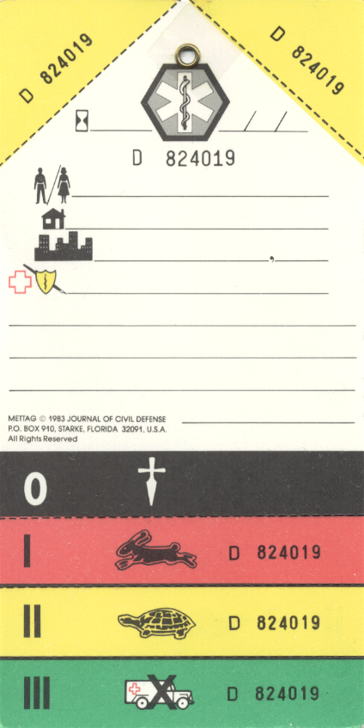
The START Triage System
Simple Triage And Rapid Treatment

Slide 11
START Victim Assessment Order
START WHERE YOU STAND
Every victim gets a tag.
Identify all “Walking Wounded” first – these are, by definition, “Minor” whether they are bruised, cut, have broken bones or other, non-life threatening injuries.
If they are not breathing even after repositioning the airway they are “Morgue”.
Next, if they fail any part of RPM they are “Immediate”.
If they pass RPM they are “Delayed”.

Slide 12
Patient Assessment…RPM
Three things to check…
Respirations
Perfusion
Mental Status
Anyone who is unconscious is an “Immediate” by definition!

Slide 13
RPM Mnemonic
R
P
M
30
2
Can Do

Slide 14
RPM…Respirations
No breathing or Agonal respiration
Position airway, if still not breathing try it again
If pediatric and there is a peripheral pulse, give 5 mouth to barrier ventilations.
If apnea persists, tag as MORGUE and move on to next person.
Agonal respiration is an abnormal pattern of breathing characterized by gasping, labored breathing, accompanied by strange vocalizations and muscle twitches.
Notes:
BREATHS – Breaths must be good

Slide 15
Agonal Respirations
Notes:
BREATHS – Breaths must be good

Slide 16
RPM…Respirations
Range…Adults under 30 breaths a minute
Children to 12 years: 15-45 breaths/min
Out of range for breaths per minute
Tag as IMMEDIATE and move on to next person
Within range for breaths per minute
Go to the next step… Perfusion
Notes:
BREATHS – Breaths must be good, effective breathing
See chart to follow about normal breathing rates

Slide 17
RPM…Perfusion…Blanch Test
Goal…Adult perfusion in under 2 seconds
More than 2 seconds
Tag as IMMEDIATE and move on to next person
Less than 2 seconds
Go to next step… Mental Status
Capillary refill may not adequately reflect peripheral hemodynamic status in a cool environment, especially in children.
Notes:
Check perfusion because adult pulse is frequently hard to find. In children a pulse is much easier to find.

Slide 18
RPM…Pediatric Pulse
Goal…Pediatric peripheral pulse
If no peripheral pulse is present (in the least injured limb), Tag as IMMEDIATE and move on to next person
If peripheral pulse is palpable
Go to next step… Mental Status

Slide 19
RPM…Mental Status
Goal…follow simple command
Adult cannot follow directions
Tag as IMMEDIATE and move on to next person
Adult can follow directions
Tag as DELAYED and move on to next person

Slide 20
RPM…Mental Status
Obeying commands may not be an appropriate gauge of mental status for younger children. Use AVPU system.
Alert – a fully awake (although not necessarily oriented) patient
Verbal - the patient makes some kind of response when you talk to them
Pain – the patient responds to painful stimuli
Unresponsive

Slide 21
RPM…Mental Status
Child if Unresponsive
Tag as IMMEDIATE and move on to next person
Child if Alert, responsive to Verbal, or appropriately responsive to Pain
Tag as DELAYED and move on to next person
Notes:
A, V or appropriate response to mild painful stimuli, such as touching the hand or foot is OK
If you need a sharp painful stimuli to get a reaction or victim is Unresponsive then Fail

Slide 22
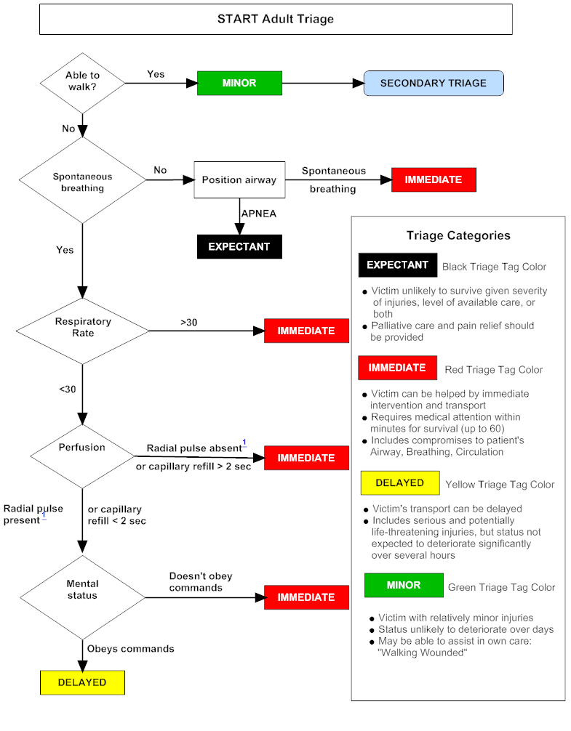
START Algorithm

Slide 23
“ MINOR ”
Walking wounded
Do not require immediate care
“Screamers”
Use as helpers to care for others
All children carried to the GREEN area by other ambulatory victims must be the first assessed by medical personnel in that area.

Slide 24
“ MORGUE ”
Non-breathers who fail to breathe after airway has been cleared
Considered Non-Salvageable
Mortal injuries
May be obviously dead
Pulseless
Also termed “Expectant”, “Deceased”, “Dead”, “Non-Salvageable”, etc.

Slide 25
“ IMMEDIATE ”
Life Threatening Injury
Victim needs immediate care
Fails R – P – M check
Adult >30 respirations per minute
Child outside 15-45 respirations/m
Pediatric, no palpable pulse
Capillary refill > 2 seconds
Fails Mental check

Slide 26
“ DELAYED ”
Serious Non Life Threatening Injury
Did not walk out of scene
R-P-M within in acceptable limits
May have broken bones
May be extrication problem
May have chest pain, etc.

Slide 27
Treatment During START Triage
There are two treatments that may be given during triage:
Stop haemorrhagic blood flow
Open the airway
External bleeding should be controlled by direct pressure. If direct pressure fails, a tourniquet should be used in the case of severe hemorrhage that cannot be controlled by direct pressure. Tourniquet use in civilian first-aid is now advocated as part of the C-ABC approach. Other techniques such as elevation and pressure points are not always effective but should still be attempted. As a rule of thumb, anywhere you can feel a pulse can be used as a pressure point to stop bleeding (with the obvious exception of the carotid pulses!).
Notes:
C-ABC = The military frequently use CABC. With the first C standing for catastrophic haemorrhage. It is hypothesised that major bleeding will kill a casualty before an airway obstruction and with the development of quick and easy to apply haemostatic agents controlling blood loss should occur first.

Slide 28
BLACK Category Triage
Unless clearly dead or suffering from injuries incompatible with life, victims tagged in the BLACK category should be reassessed once critical interventions have been completed for RED and YELLOW patients.
Palliative care should be provided to those still alive.

Slide 29
Victim’s Property
Try to bag any property
Bag any severed body part and keep cool, if possible
Keep property and body parts with the victim, preferably attached
If a victim is dead, try to not touch the body. This is a crime scene.
Preserve evidence

Slide 30
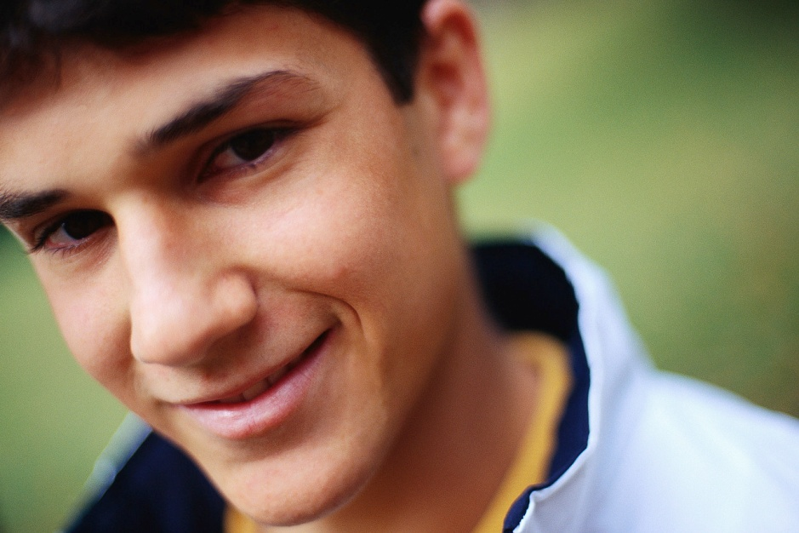
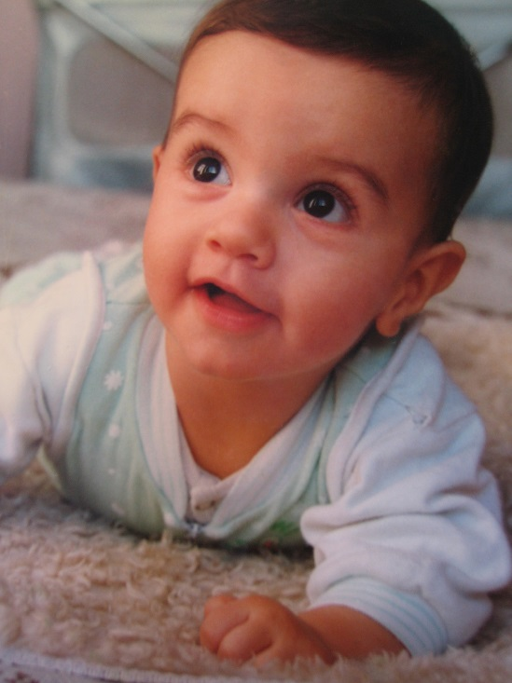
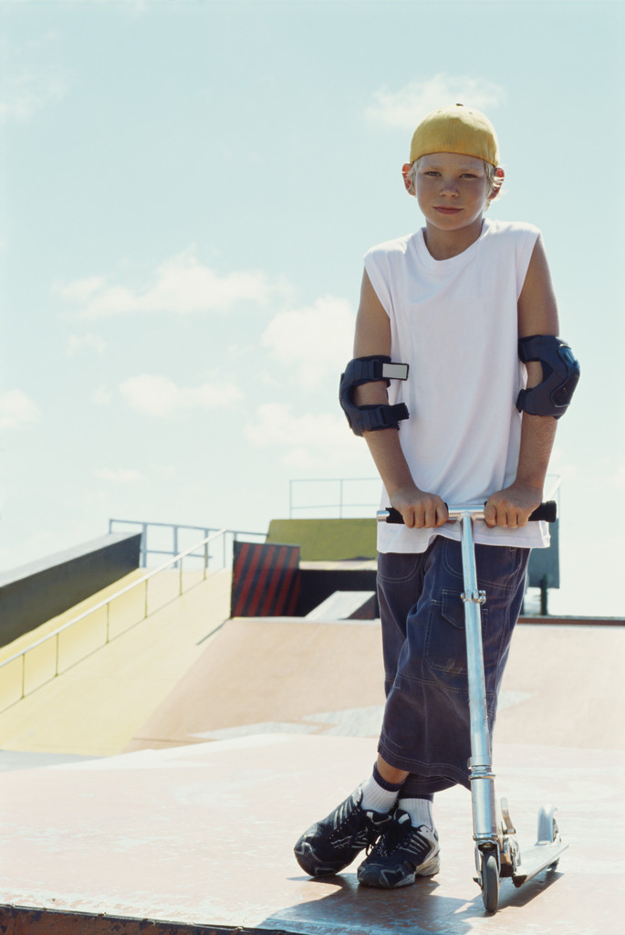
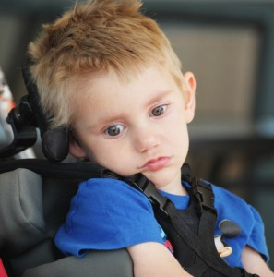
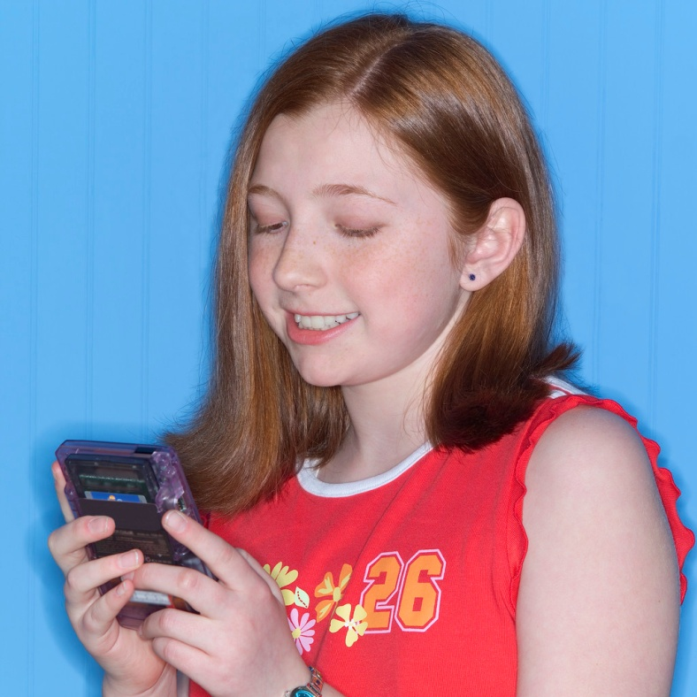
S
KIDS

Slide 31
Special Considerations in Children
Pediatric Age and Size
Ages to 12 years
Less than one year of age is less likely to be ambulatory.
The pertinent pediatric physiology (specifically, the airway) approaches that of adults by approximately eight years of age.
The ages of “tweens and teens” can be hard to determine so the current recommendation is:
If a victim appears to be a child, use JumpSTART.
If a victim appears to be a young adult, use START.

Slide 32
Special Considerations in Children
Pediatric Characteristic | Special Risk During Disaster
Respiratory | Higher minute volume increases exposure to inhaled agents. Nuclear fallout and heavier gases settle lower to the ground and may affect children more severely.
Gastrointestinal | May be more at risk for dehydration from vomiting and diarrhea after exposure to contamination.
Skin | Higher body surface area increases risk of skin exposure. Skin is thinner and more susceptible to injury from burns, chemicals and absorbable toxins.
Thermoregulation | Less able to cope with temperature problems with higher risk of hypothermia.
Developmental | Less capability to escape environmental dangers or anticipate hazards.
Psychological | Prolonged stress from critical incidents. Susceptible to separation anxiety.
Notes:
Higher minute volume per body mass

Slide 33
Special Considerations in Children
Age | Normal Respiratory Rates | Normal Pulse Rates
Infant (<1 Yr) | 30-60 | 100-160
Toddler (1-3 Yrs) | 24-40 | 90-150
Preschooler (4-5 Yrs) | 22-34 | 80-140
School Age (6-12 Yrs) | 18-30 | 70-120
Adolescent (12-18 Yrs) | 12-20 | 60-100

Slide 34
Special Considerations in Children
Mechanisms of Injury
Head injury. Head injuries account for approximately 60% of all MCI and disaster injuries in the pediatric population. This high rate can be explained by the large and heavy heads of children relative to their bodies. Furthermore, in states of unconsciousness, children’s upper airways tend to get obstructed by their relatively large, flaccid tongue or kinked because of the large head flexion induced by the short occiput.
Skeletal injury. Children have more pliant and flexible bones than adults and are therefore subject to fewer bone fractures. However, internal organ injuries in the absence of fractures of the overlying bones, in the chest or upper abdomen for example, are not uncommon.

Slide 35
Special Considerations in Children
Mechanisms of Injury
Thermoregulation. The less mature thermoregulatory mechanism in children and higher surface area-to-mass ratio compared to adults make heat loss and hypothermia more common in the pediatric population, particularly during exposure to extreme conditions, such as cold weather, decontamination with cold water during biochemical events, or when undressed at triage.
Blood loss. As children have relatively small amounts of blood, what may seem to be minor bleeding may in effect represent a significant volume loss and severe shock. Their cardiovascular system is generally free of chronic disabling conditions, therefore, children may tolerate hypovolemic stress better than adults.

Slide 36
Special Considerations in Children
Mechanisms of Injury
Emotional trauma. In addition to physical injuries, emotional trauma, caused for example by separation from the parents, is an important factor in pediatric care.

Slide 37
Special Considerations in Children
Prognosis
Children tolerate multiple organ injuries better than adults, and prognosis usually depends on the severity of the head injury, if present. Children have a better prognosis for most, if not all, disaster-related conditions.
An apneic child is more likely to have a primary respiratory problem than an adult. Perfusion may be maintained for a short time and the child may be salvageable.

Slide 38
Modification for non-ambulatory children
WHO
Infants who normally can’t walk yet
Children with developmental delay
Children with acute injuries preventing them from walking before the incident
Children with chronic disabilities

Slide 39
Modification for non-ambulatory children
Evaluate using the JumpSTART algorithm
RED if any RED criteria
GREEN if no significant external injury
YELLOW if significant external signs of injury are found (i.e. deep penetrating wounds, severe bleeding, severe burns, amputations, distended tender abdomen)

Slide 40
Children with Disabilities
Patients’ limitations in ambulation, communication and differentiation between acute and chronic neurological conditions are the main challenges in the triage of children with special needs and disabilities.

Slide 41
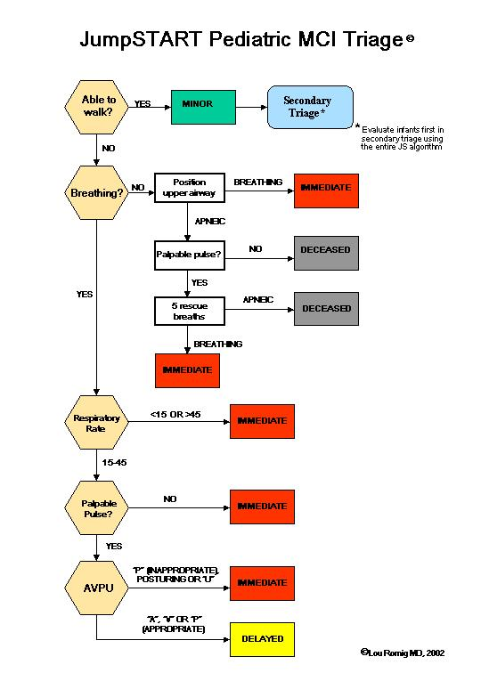
JumpSTART Algorithm
Notes:
Infants can breathe at higher rates – up to 60 is normal.

Slide 42
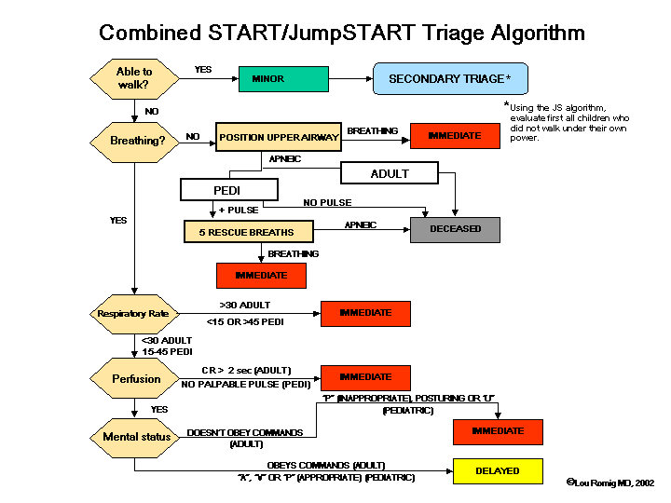
Combined START /JumpSTART Algorithm

Slide 43
Special Considerations in Elderly
Characteristic | Special Risk During Disaster
Respiratory | Lower respiratory efficiency decreases ability to exhale any inhaled agents. Minute volumes decrease with age.
Gastrointestinal | May be more at risk for dehydration from vomiting and diarrhea after exposure to contamination.
Skin | Frail bodies have higher body surface area ratio to body mass which increases risk of skin exposure. Skin is thinner and more susceptible to injury from burns, chemicals and absorbable toxins.
Thermoregulation | Less able to cope with temperature problems with higher risk of hypothermia and hyperthermia.
Psychological | Failing mental abilities may prevent ability to help with own care.
Notes:
Higher minute volume per body mass

Slide 44
Triage Systems Overview
Many Triage Systems have been developed throughout the world. Some of the more common ones are:
START
Triage Sieve
Care Flight Triage
MASS Triage
SACCO Triage Method (STM)
SALT
Notes:
Quickly go through the next 6 slides just to show there are many systems, some simple, some complex.

Slide 45
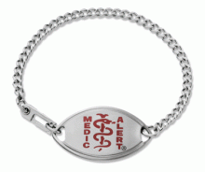
Head-to-Toe Assessment
Once Triage is complete, move victims to a Treatment Area for Assessment
Conduct on all victims, even
those who seem to be alright
Look for medical identification
Children are assessed Toe-to-Head
Everyone gets an assessment tag
Verbal assessment
Hands-on assessment
look, listen and feel for anything unusual

Slide 46
Secure the Area
Control Flow of Traffic
Ideally one road in, one road out
Control Flow of People
Separate Injured Patients, Families, Media
Protect Resources

Slide 47
Secure the Area
Family Area
Media
Perimeter
Expectant/
Morgue
Perimeter
Treatment
Leader
RED:
Immediate
ENTRY Control Point
EXIT Control Point
YELLOW:
Delayed
Transportation
Unit
Medical Supply Coordinator
Minor
Management
Area
GREEN:
Minor
Perimeter
Perimeter

Slide 48
Take Home Points
Resist the urge to treat during triage.
Know that MCI Triage algorithms are NOT perfect and should be considered guidelines, not absolutes
Continuous reassessment is a must, especially with pediatric patients.

